Slide 1


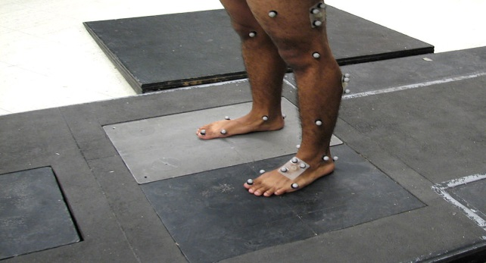
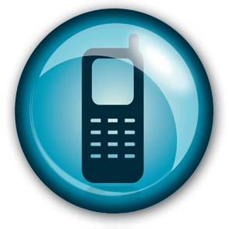
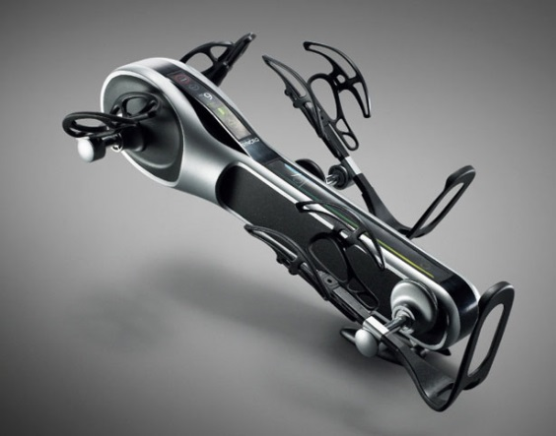
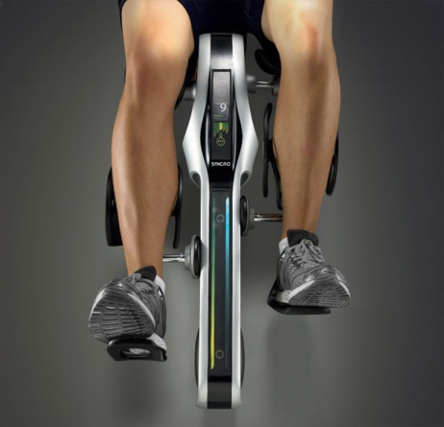
Sensory Data
Video Capturing
Streaming Multimedia
Rehabilitation Device

Slide 2
Video Streaming and Control
Scalability Control
SNR, Spatial Domain Scalability
Temporal Streaming
Multiplexed Streaming
Sensory Data and Captured Image(Motion)
Control/Command for Scalability
Device Control
Rehabilitation Device Control
Autonomous Feedback Control

Slide 3
Application
Motion Wellness Progress Tracking System
Pediatric Rehabilitation
Orthopedic Rehabilitation
Therapical Clinics at Home
Physical Therapy
Feedback and Tracking of Motion Wellness

Slide 4
Other Applications
Speech and Language Recovery
Text Prompter/ Audible Device may apply
Speech Recognition system
Preventing Obesity
Vital sign monitoring(BP, ECG, HBR…)
Physical Training Program for Weight Loss
Self-Management of food control with Calorie monitoring
BCI with Prosthetic Device

Slide 5
Technology
Digital Image Processing with Streaming
SNR(QoS) Scalability
Spatial Domain Scalability
Temporal Streaming with Data/Command
Mobile Rehabilitation (Medical) Data Communication
Profile based Platform for Rehabilitation Devices and Data types
Pro-Active Scalability Control by Feedback

Slide 6
Technology
Rehabilitation Device Control
Profile based common Platform for Configuration/Control
Rehabilitation Program Database
Autonomous Controlling the Rehabilitation Devices by Feedback

